Slide 1
Evolutions possibles ICRH de WEST
24 septembre 2019
J.Hillairet, L.Colas, P.Mollard, G.Lombard, J-M.Bernard

Slide 2
Contexte de la réunion
Pour répondre à cette demande, je souhaite que l’on fasse ensemble un point technique sur le système ICRH de WEST :
· Statut du système : puissance max injectée par antenne, fiabilité, compatibilité technique LHCD, etc.
· Potentiel du système en l’état : puissance max possible sur les plasmas de WEST actuels et estimation en mode H, indépendamment du rayonnement et autres problèmes de contrôle
· Impact attendu d’un dépôt de bore sur les protections latérales : contribution de cette source par rapport aux autres, résultats d’ASDEX Upgrade avant le dépôt et après le dépôt sur une antenne similaire en terme de puissance totale rayonnée ?
· Modifications des antennes de WEST : pour augmenter la résistance de couplage ?
Je propose de faire une première réunion pour explorer toutes les pistes (sans analyse des ressources et de planning à ce stade), la semaine du 16 au 20 septembre. On validera les éventuelles actions à lancer lors d’un prochain COPIL HCD.

Slide 3
Take-home message: there are margins for improvements
ICRH System Improvements
Q2 coupling resistance normalization
Phase control
Plasma Scenario Improvements
LSN vs USN shows large uncertainties with LFS plasma radial location
Impurity Production
P_{rad} during ICRH sometimes larger than with LH.
Measurable contribution of IC limiters to core contamination.
Low-Z material → may reach similar f_{rad} during ICRH and LH.
Local Gas puffing recipes
Tbd, especially if better pumping in C5
From coupling POV:
4 MW IC
demonstrated
6 MW IC (60 s)
seems achievable
Impurity production needs to be reduced
Operation domain/recipes

Slide 4
Système ICRH – Bilan C4 et évolutions possibles

Slide 5
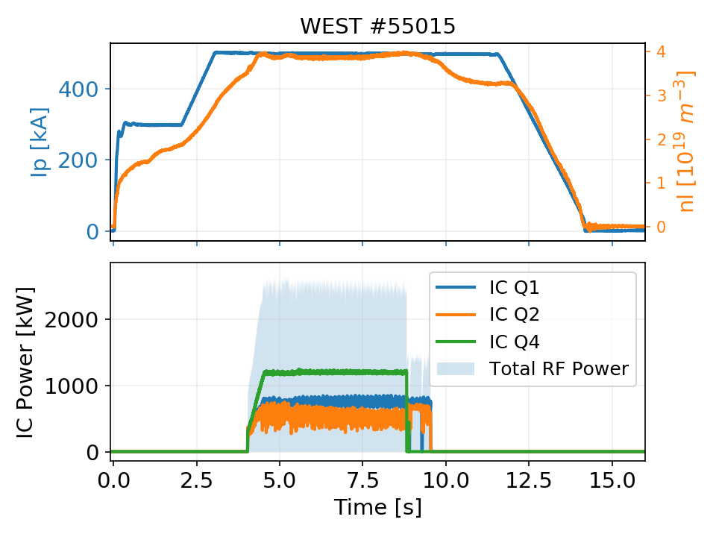
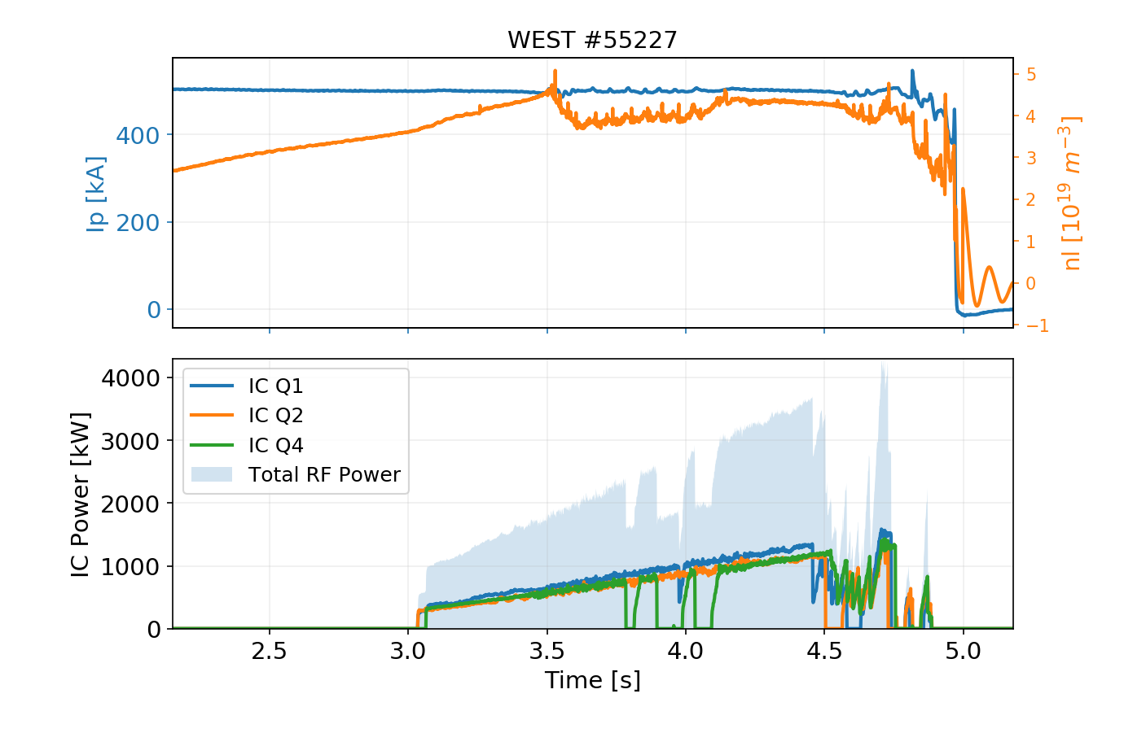
C4 Statistics (preliminary)
Main C4 Results
RF plant reliable due to good maintenance during shutdown
All three antennas operational simultaneously on plasma few times 3 MW/few seconds, 4.2 MW peak.

Slide 6
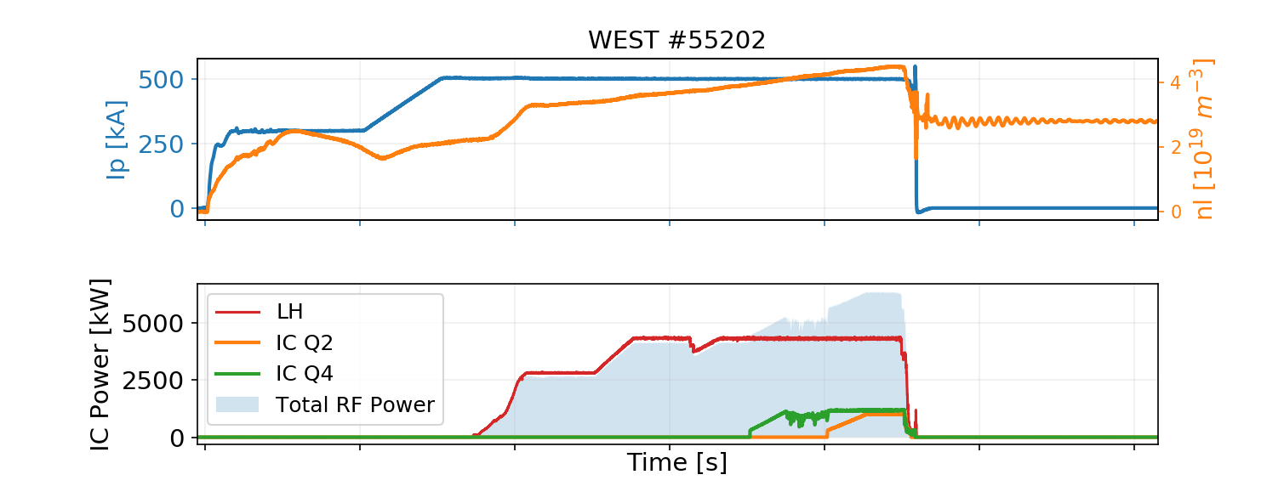
C4 Statistics (preliminary)
Main C4 Results
RF plant reliable due to good maintenance during shutdown
All three antennas operational simultaneously on plasma few times 3 MW/few seconds, 4.2 MW peak.
Up to 2.4 MW (2 antennas) in // with LH (but impurity problem)

Slide 7
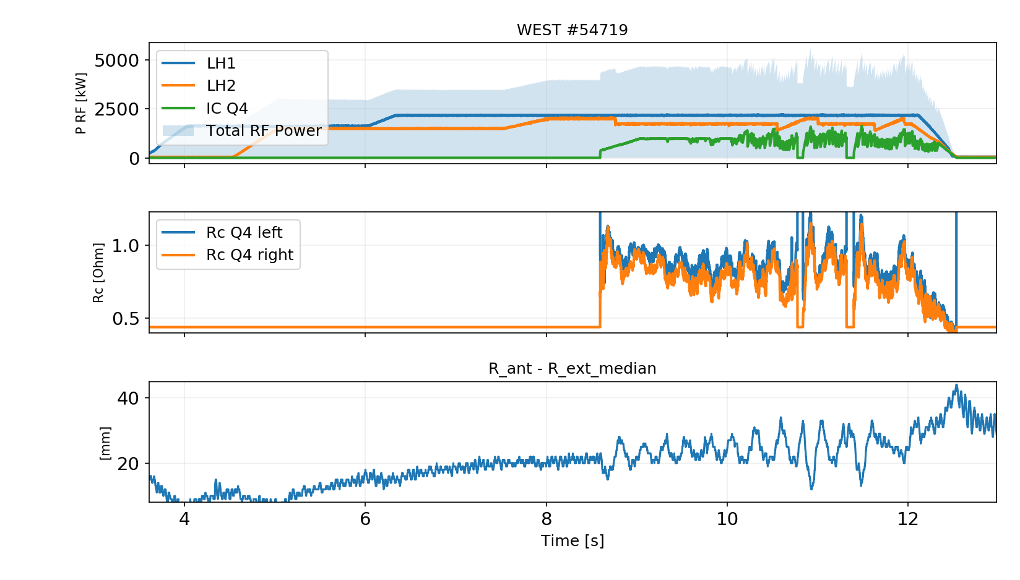
C4 Statistics (preliminary)
Main C4 Results
RF plant reliable due to good maintenance during shutdown
All three antennas operational simultaneously on plasma few times 3 MW/few seconds, 4.2 MW peak.
Up to 2.4 MW (2 antennas) in // with LH (but impurity problem)
Load resilience confirmed

Slide 8
C4 Statistics (preliminary)
Main C4 Results
RF plant reliable due to good maintenance during shutdown
All three antennas operational simultaneously on plasma few times 3 MW/few seconds, 4.2 MW peak.
Up to 2.4 MW (2 antennas) in // with LH (but impurity problem)
Load resilience confirmed
Incidents:
Regular maintenance performed on plant
Delay on Q4 startup due to cabling defects
Few problems with the hydraulic system (cylinders, position encoder) → All solved during maintenance
One voltage probe out of order on Q1 (cable?) →Investigations during S4
One capacitor of Q2 can’t move since its servopack is out of order. Obsolete component, bought online second hand. → Full update of the servomotors and control systems during S4

Slide 9
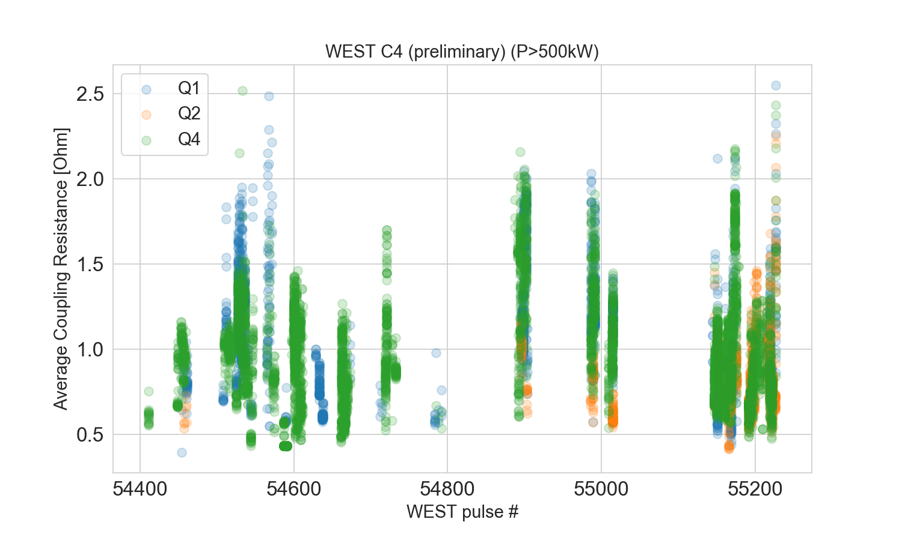
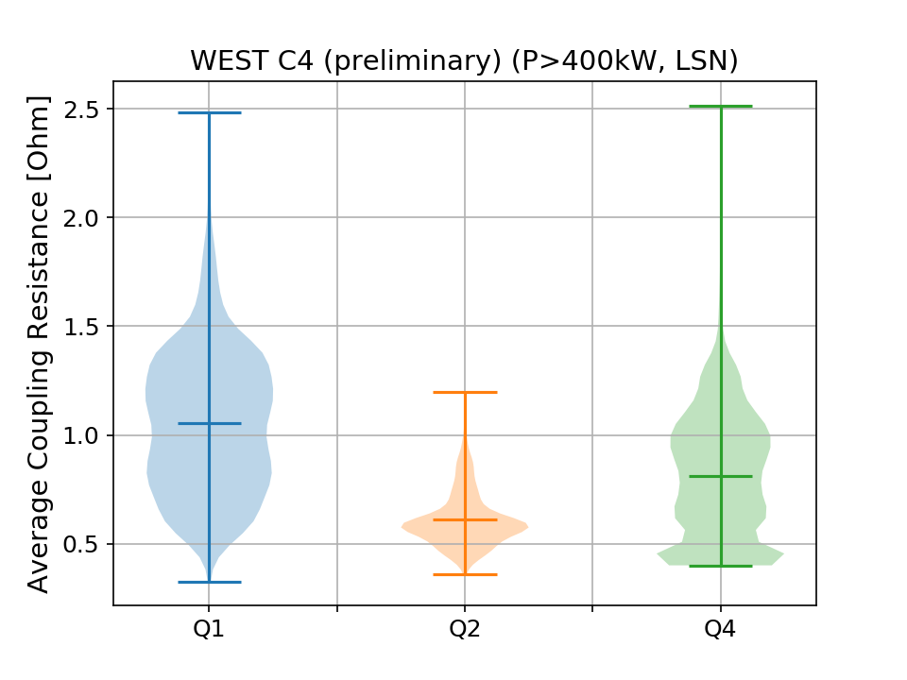
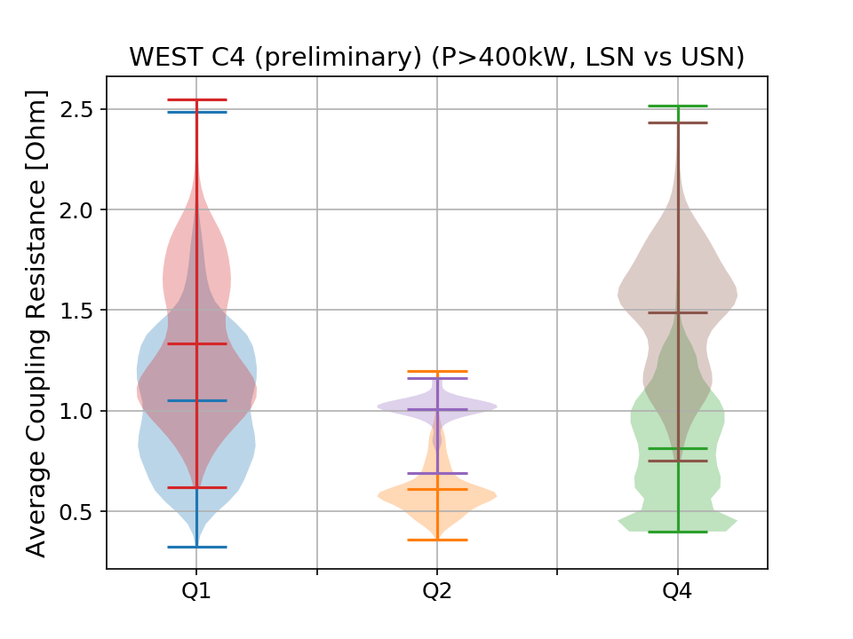
ICRF Coupling during C4 (preliminary)
Still clear difference with Q2
Average coupling resistance for WEST C4 is
between 0.8 -1.0 Ω for Q1 and Q4
Closer to 0.6 for Q2
Clear difference between LSN and USN plasmas for all antennas
Plasma control

Slide 10
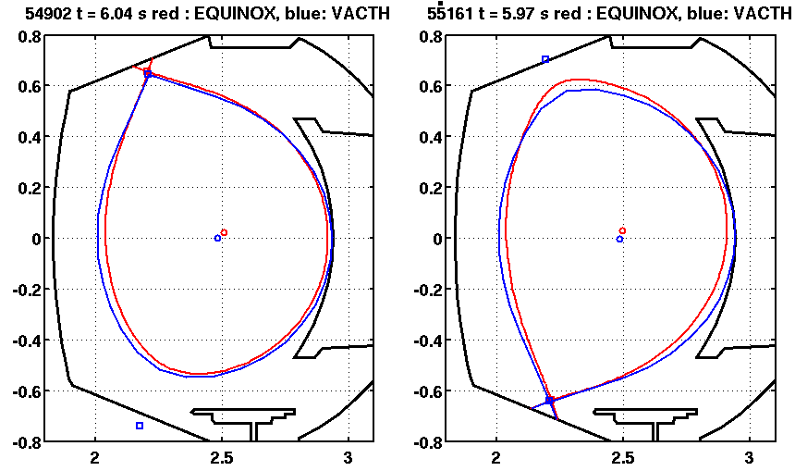
Plasma control
Comparison btw VACTH and EQUINOX equilibrium (500kA/3.6T plasmas)
En USN, différence de l’ordre de 15mm sur le Rext.
En LSN, différence de .. 40mm !
→ Would explain coupling difference measured btw LSN and USN?
Conclusion: probably margin for coupling improvements in C5
From N. FEDORCZAK (18/09)

Slide 11
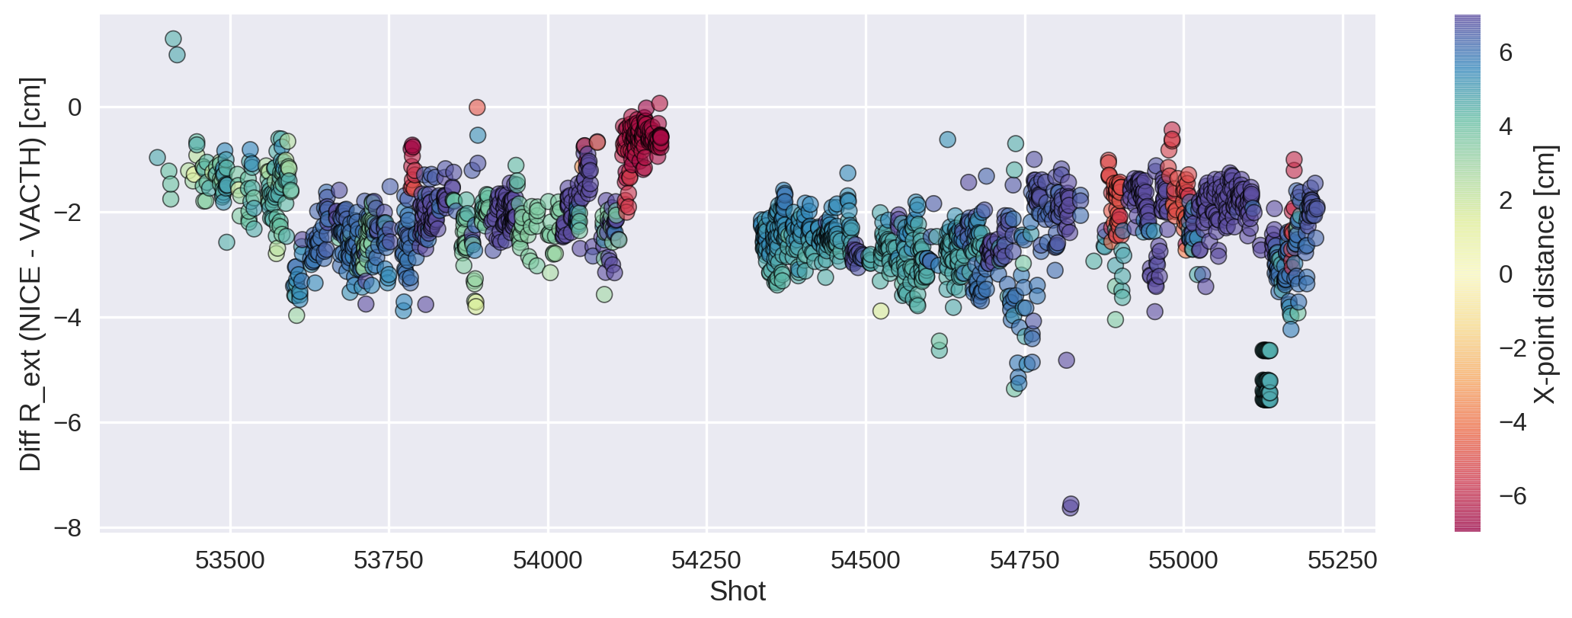
Plasma control
Ecart dans la position R_ext entre NICE et VACTH.
En moyenne il y a un écart de 2cm, la valeur calculé par VACTH est plus grande.
Evolution en fonction du numéro de choc
la différence négative montre que R_ext_vacth > R_ext_nice.
Pour la configuration USN l’écart est légèrement plus faible.
Les points rouges (distance point X négative) sont USN, les points bleus (positifs) sont en LSN.
Bonne soirée,
Jorge
Jorge Morales 23/09/219

Slide 12
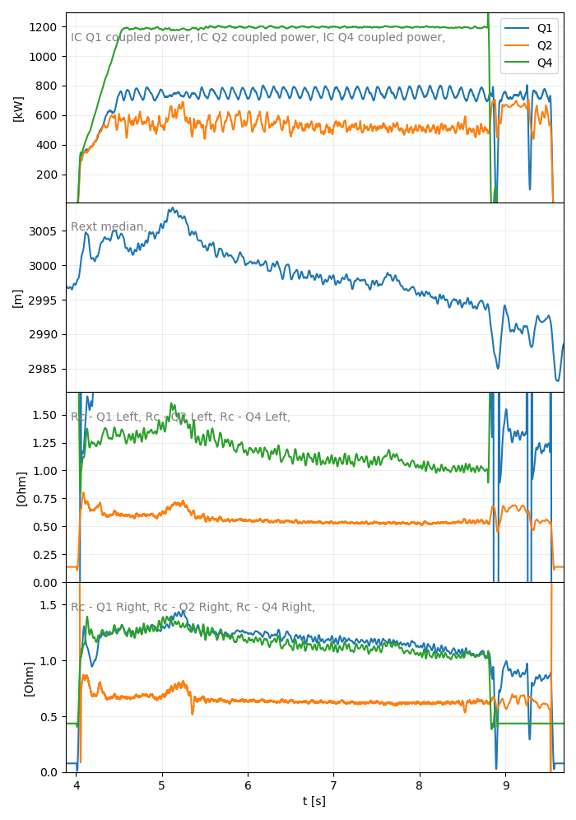
Radial position drift with time ex: #55015
Plasma LCFS moves away from the antennas
Coupling resistances drop
Leads to power regulation and/or trips
Corrections in progress (week 38)
-14mm

Slide 13
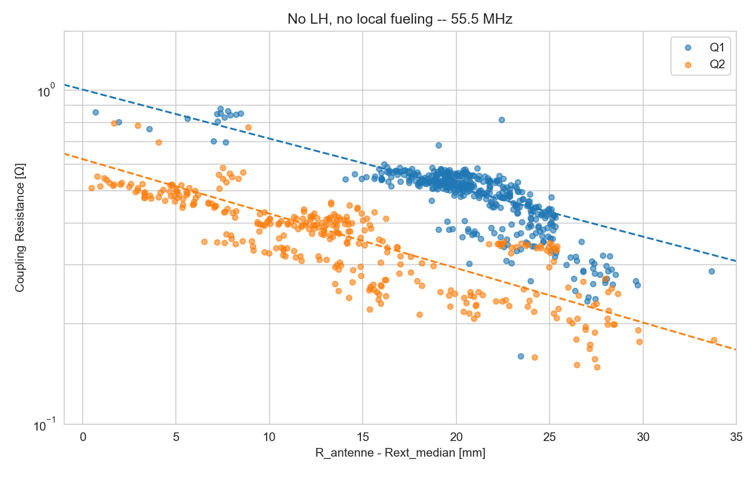
Q2 Coupling Resistance
Q2 coupling resistance has been found different from Q1 during the C3 campaign
Coupling resistance is deduced from voltages and power measurements
→ Power measurements recalibrated during S3, still difference clearly remains.
In C4, the coupling of Q1 and Q4 has been found equivalent.
→ seems to indicate a peculiarity of Q2
Conclusion: difference in Q2 voltage probe calibration as most probable explanation
C3b: Rc vs distance antenna/LCFS
Such behaviour could be explained by a dist. diff. to LCFS ~ 10-15 mm
→ Can’t be explained by mechanical differences (cf. measures), since:
- strap/FS distance is 30.5 mm (-1.6/ +2.2)
⁻ Antenna radial positions checked during S3

Slide 14
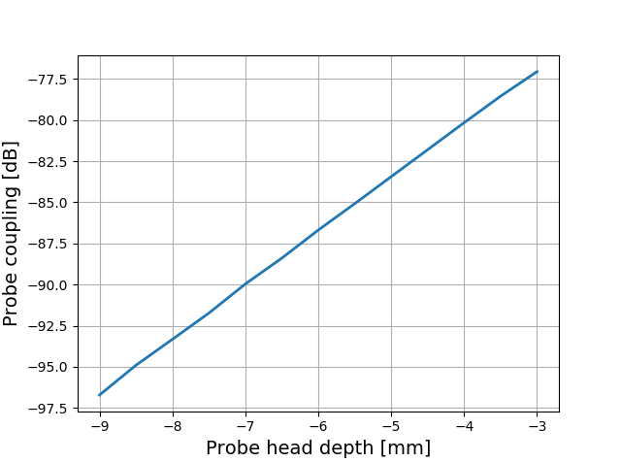
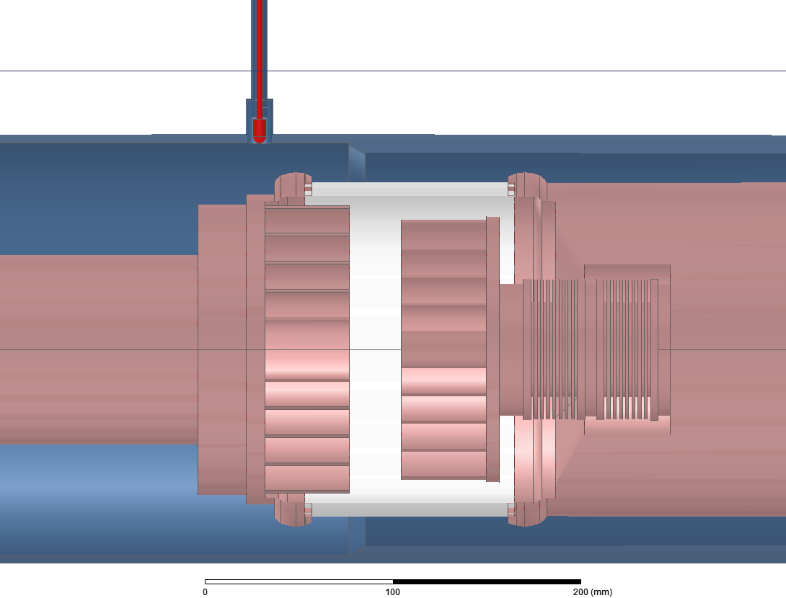
WEST Antenna voltage probe calibration procedure
Probes are calibrated at low frequency (~1 MHz)
Calibration data are then extrapolated to nominal frequencies (48 to 63 MHz)
Probe coupling is *very* sensitive to its depth in its port
Probe head depth
~ 3.3 dB/mm from modelling/measurements
0
Q2 was the first antenna to be assembled and calibrated
Probes have been disassembled then reinstalled *after* the calibration (for welding access) → mechanical error between 1st and 2nd assembly?

Slide 15
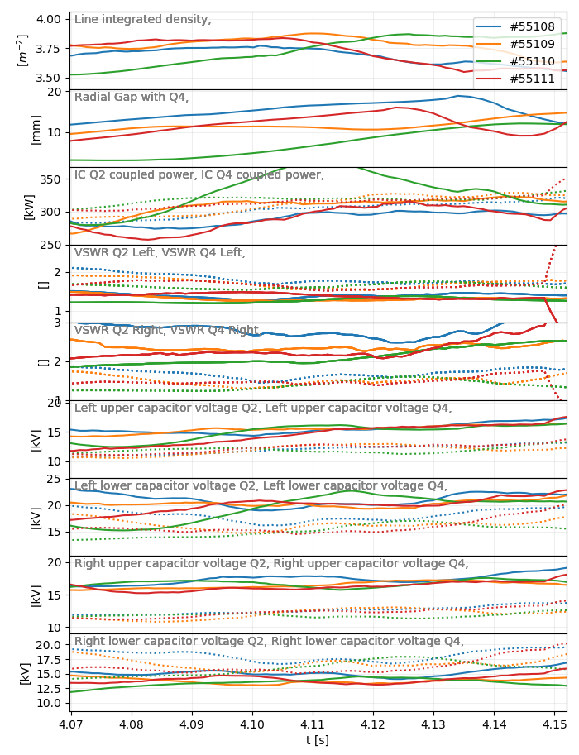
How Q2 voltage probe calibration should be modified to match Q1 and Q4?
From similar shots from Friday 13/09
Voltages compared btw Q2 and Q4 during 4.06 et 4.16 for pulses 55108 to 55114
Caveat: VSWR not exactly identical (frozen capacitor positions)
 | V_{Q2} | V_{Q4} | V_{Q2}/V_{Q4}
Gauche Haut | 15 | 11.95 | 1.25
Gauche Bas | 19.9 | 16.1 | 1.23
Droit Haut | 16.7 | 12.3 | 1.35
Droit Bas | 13.9 | 16.5 | 0.84
V_{Q2} ~ 1.25 x V_{Q4} pour 3 sondes
NB: 20log₁₀(1.25) = 1.94 dB
Correction proposée: -1.94 dB pour ces 3 sondes
→ Erreur de positionnement équivalent à ~ 0.6 mm (crédible)

Slide 16
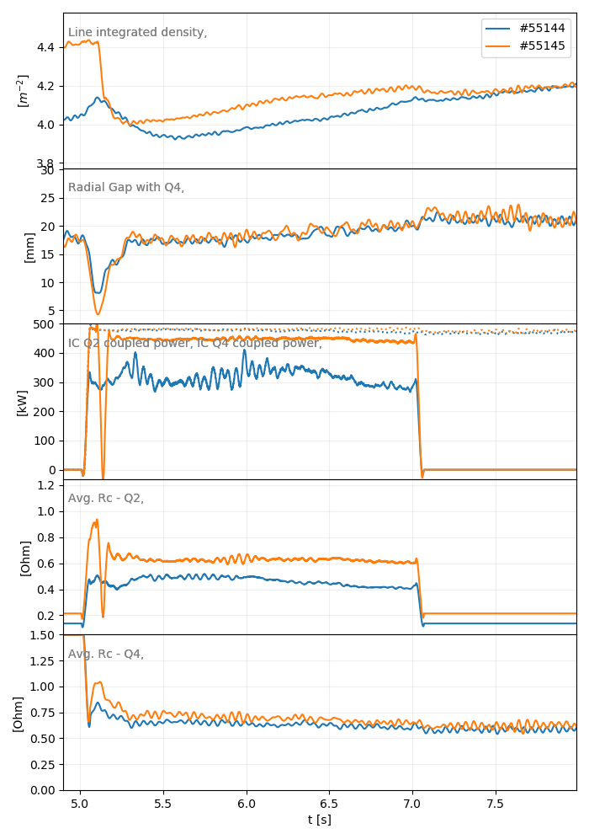
Test of the proposed modification (to be validated)
#55144 vs #55145
→ Q2 Rc increase (consequence of reduced voltages) → No more power regulation and power ~ Q4
Risks: If the cause of voltage differences between Q2 and other antennas is different than a pure calibration problem, it may increase capacitor voltages and currents to:
27 kV x 1.25 = 33.8 kV
915 A x 1.25 = 1143.8 A
Eventually: Measurements could be performed during S4 at low RF power on two antennas (side by side) with machine under vacuum.
Conclusion: validation of this modification?

Slide 17
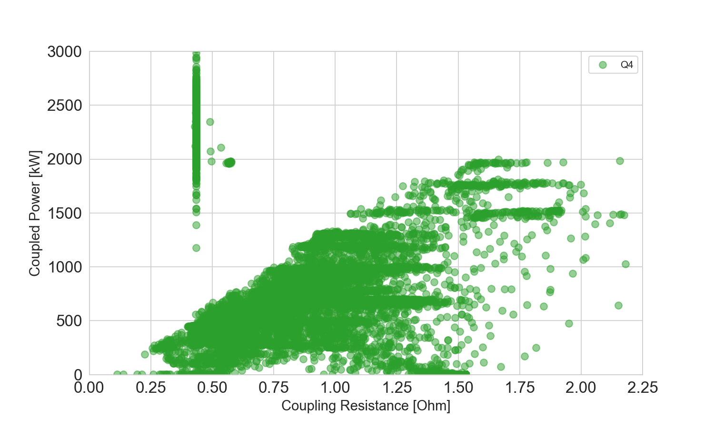
Quelle puissance peut on atteindre?
Si on prend comme référence Q4
2 MW / ant possible si Rc > 1.6 Ohm soit 6 MW pour 3 antennes
Power regulation limit: P_{max}~ 1.2 R_{c}

Slide 18
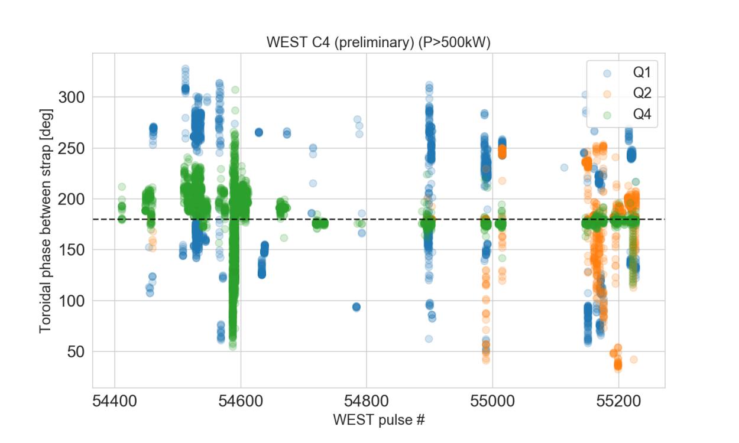
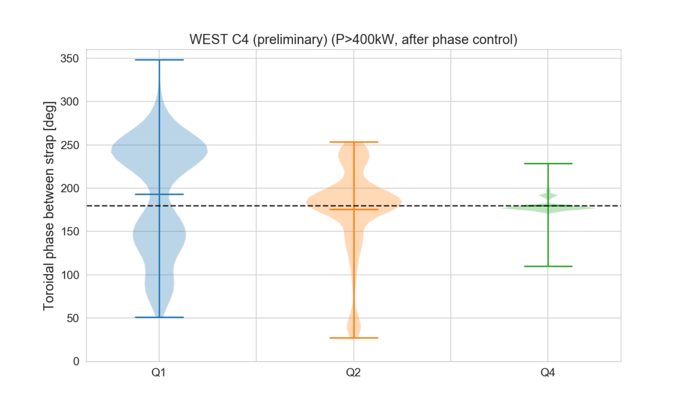
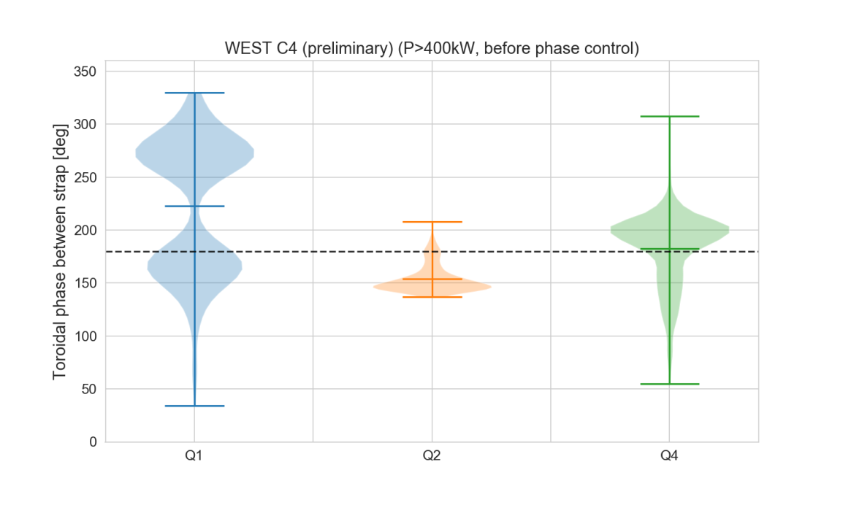
WEST Antenna Toroidal Phase Automatic Regulation
Phase control started since #54626 (but not on all antennas/at the same time)
OK for Q4
Better control for Q2
Does not work on Q1 yet
Conclusion: still margin for improvements. Need to update hardware.

Slide 19
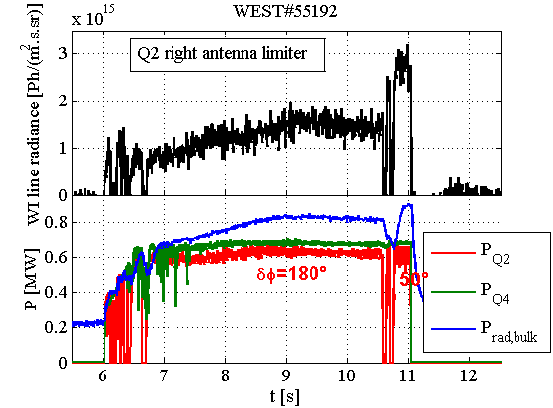
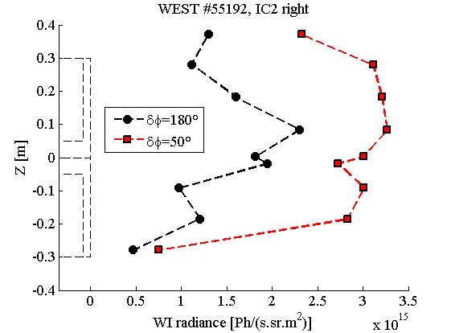
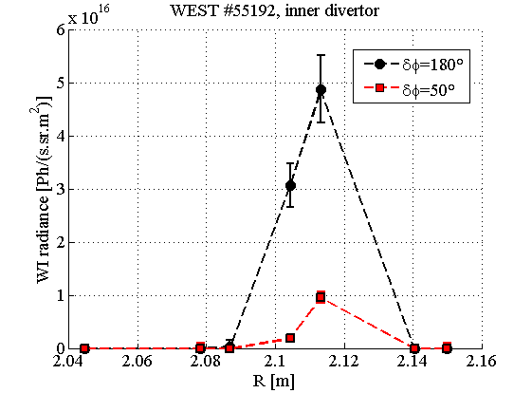
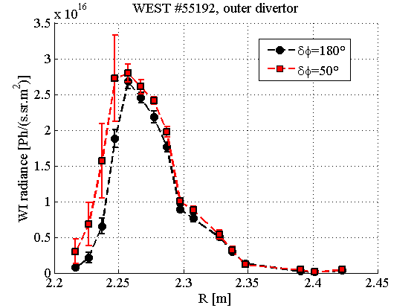
Impurity production vs phase WEST #55192
Failure in Q2 phase control leads to:
Radiated power increase
WI radiance increase on lateral limiters but not on divertor

Slide 20
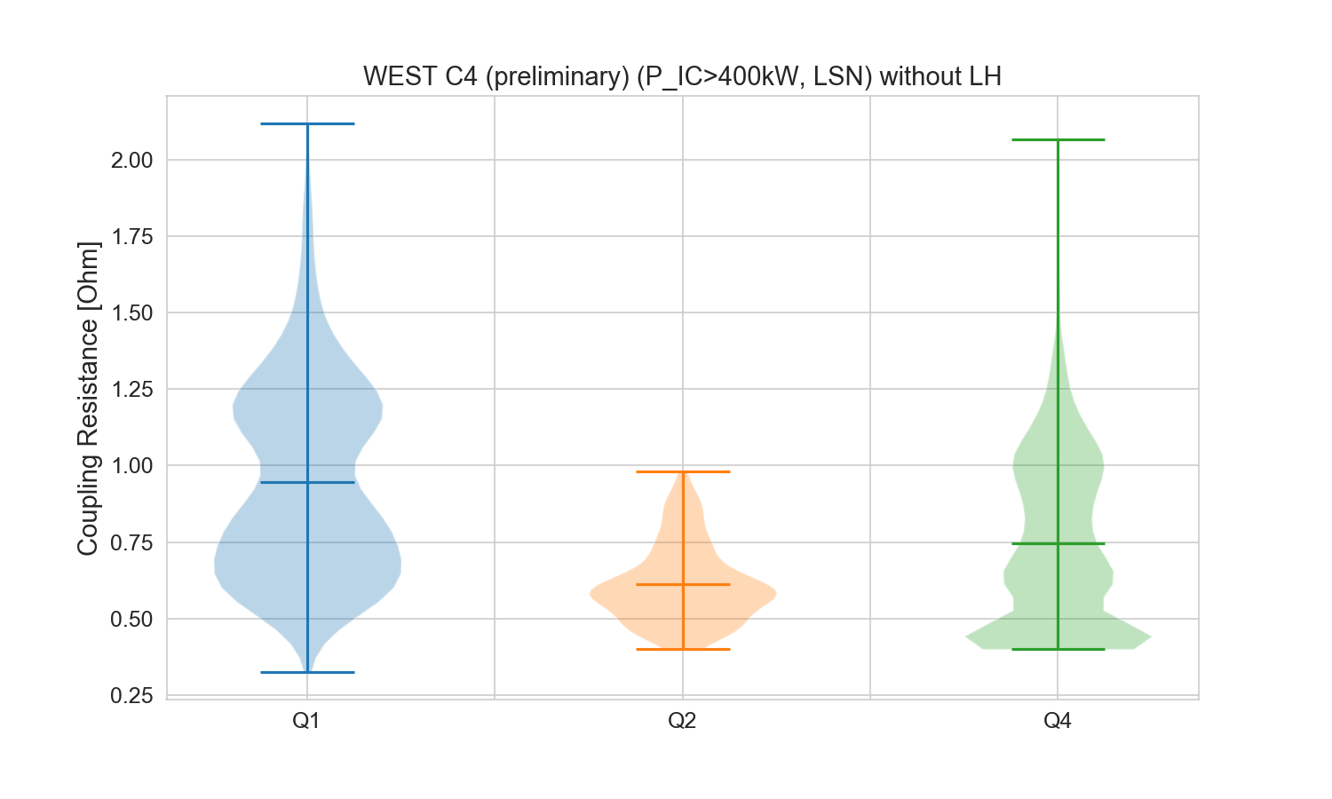
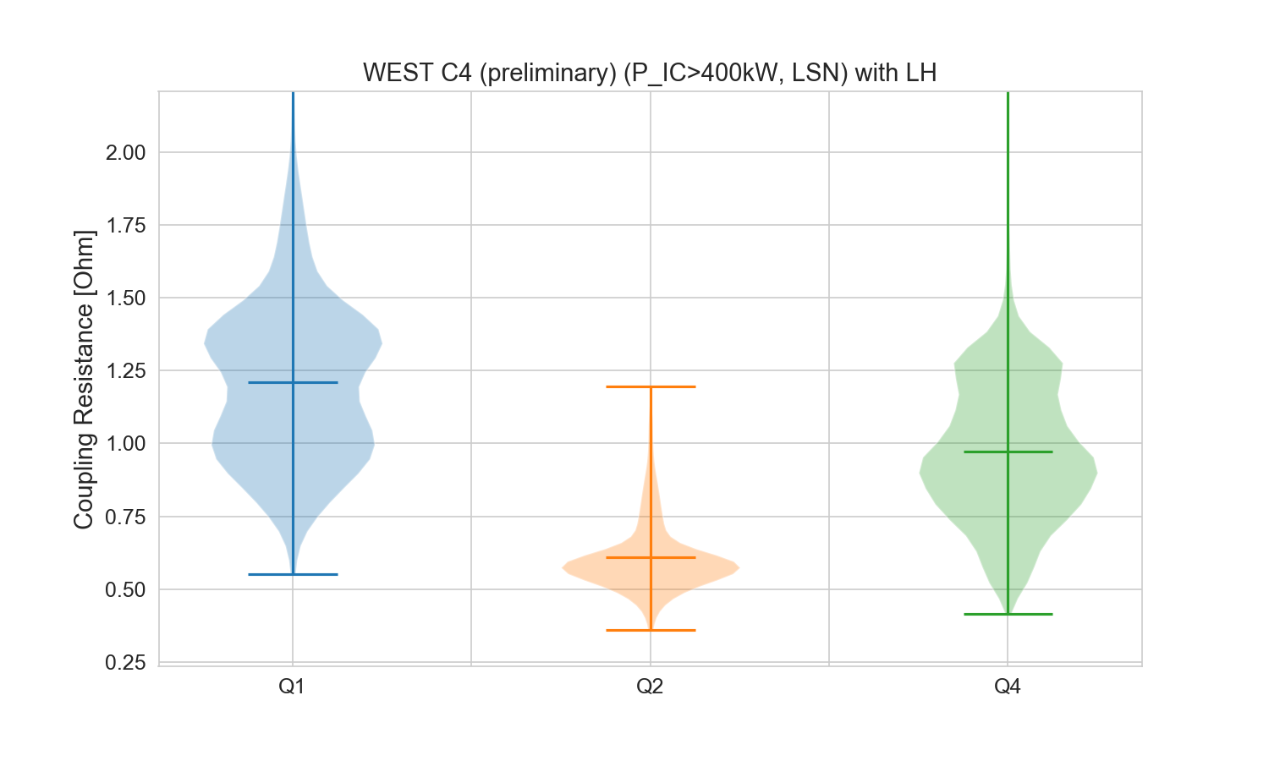
Effect of LH on IC Coupling Resistance
LH power increases the Rc average by 0.25 ohm
But important dispersion: sometime opposite effects measured
Database biased: few shot with LH and Q2

Slide 21
Antenna Modifications
Q: Can we improve coupling by modifying the antennas?
Some ideas:
Reducing the radial gap between antenna limiters and Faraday screen (few mm)?

Slide 22
Impact attendu d’un dépôt de bore sur les protections latérales

Slide 23
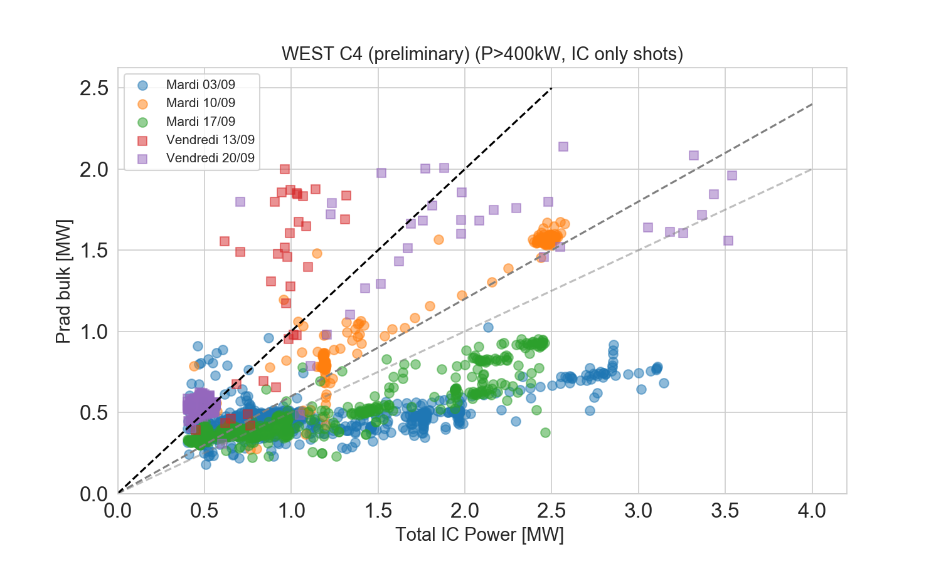
Impact de la boronisation sur la puissance rayonnée (bulk)
f_{rad}=100%
f_{rad}=60%
Phase tests
f_{rad}=50%

Slide 24
Outline, take-away message
Need more margins on P_{sep} to get « useful » H-mode on WEST
P_{rad,bulk} higher with ICRH than with LH at similar power.
Especially when both systems are combined at high power.
Experimental indications of contamination by IC side limiters
Effects of boronization on P_{rad,bulk} in IC-heated discharges.
On some sessions, the divertor source evolution is anti-correlated with P_{rad,bulk}.
Phase scans on WEST.
Effect of LH-IC combination was observed on IC limiter sources.
Clearer demonstration: W vs B-coated limiter comparison
P_{rad} reduction was measured in ASDEX upgrade.
B-coatings presently used on AUG. No operational issue reported in the litterature.
Detrimental effect of W limiters on contamination observed on EAST.
Indications for WEST.

Slide 25
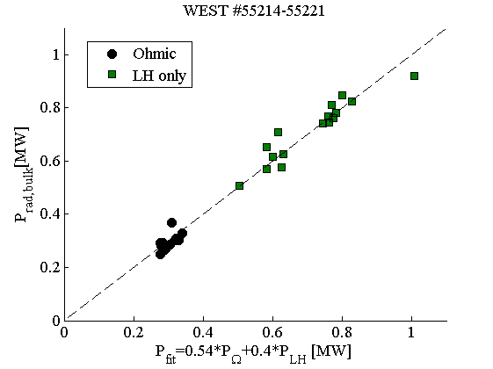
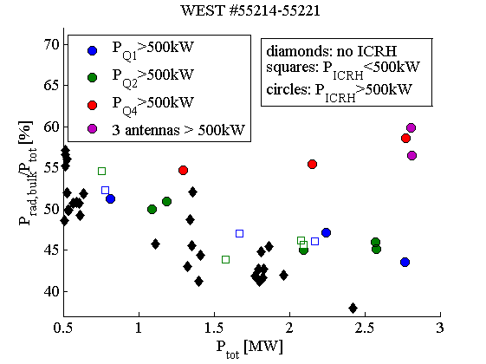
Radiated power fraction on 20/09/2019
Target plasma
LSN, Ip=500kA. Nl3~4-4,5e19
3 ICRF launchers and LH1 grill energized sequentially at similar power.
P_{LH1} Background (0,1MW,1,5MW) added on shot to shot basis.
Then 3 antennas grouped.
Detached plasma in first pulses, no visible consequence on P_{rad,bulk}.
Outer divertor

Slide 26
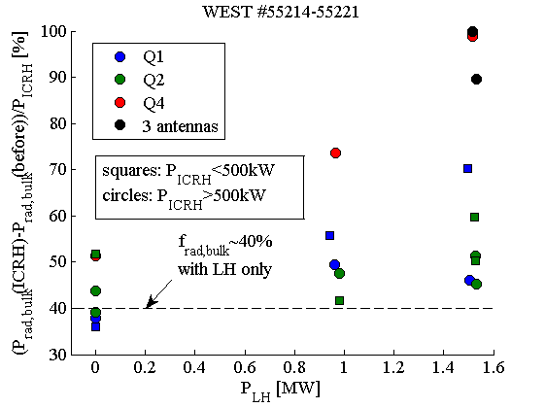
Effet of LH power on IC radiated fraction?
ΔP_{rad,bulk}/P_{ICRH} close to LH in absence of LH background.
ΔP_{rad,bulk}/P_{ICRH} generally higher in presence of LH background.
Yet large scatter, strong IC antenna dependance. Hidden parameter?
Caveat: only Q2 antenna monitored by DVIS.

Slide 27
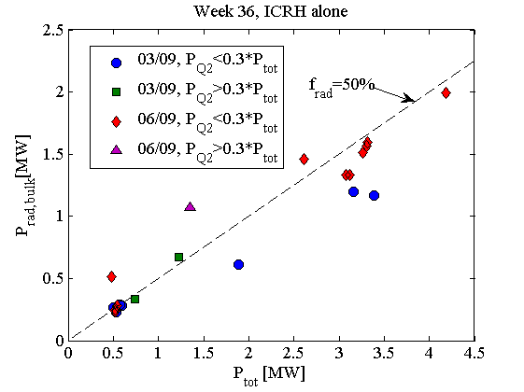


Radiation in ICRF-only discharges, week 36
Statistics with ICRH alone
Mainly USN pulses.
Boronization on 02/09.
Between 03/09 (late) and 06/09 (late): 1 session in USN, 4 in LSN, no ICRH
Frad slightly higher far from boro.
But frad less than 50% is possible with ICRH alone far from boronization… because ICRH was not used?
More bolometry signal when Q2 is used, even on 03/09. Measurement arftefact?

Slide 28
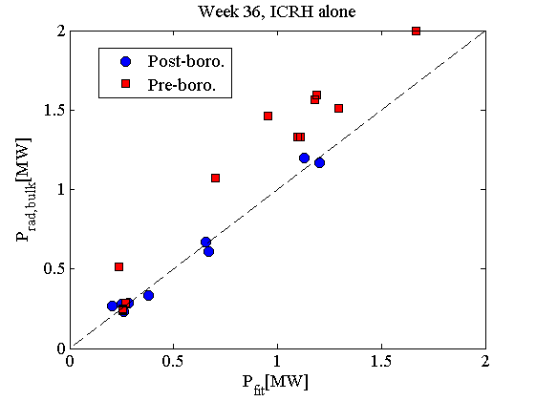
Scaling of f_{rad,bulk} in IC-heated plasmas week 36
Fit 03/09: P_{rad,bulk}=0,49*P_{Ω}+0,34*(P_{Q1}+P_{Q4})+0,57*P_{Q2}
Fit 06/09: P_{rad,bulk}=0,71*P_{Ω}+0,43*(P_{Q1}+P_{Q4})+0,60*P_{Q2}
Main boro.
effect
Boro effect preserved?
? Bolometry during Q2 ?

Slide 29
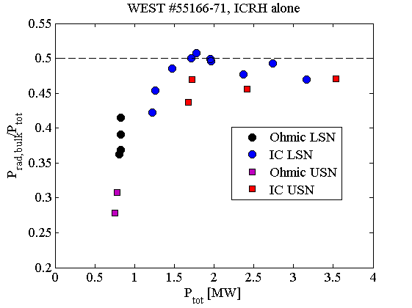
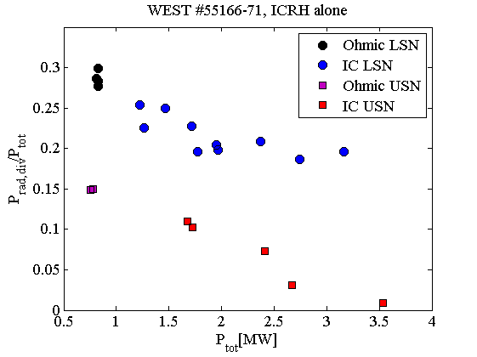
USN/LNS comparison on 18/09
Boronization on 16/09.
17/09: LSN plasmas heated by LH and ICRH (3-antennas).
18/09: ICRF-heated pulses in LSN at 700kA,
#55170: Switch to USN (clean divertor) and repeat.
Prad,bulk/Ptot: some reduction in ohmic, more marginal with ICRH
Prad,div/Ptot: reduction by 20-30% both in ohmic and IC.

Slide 30
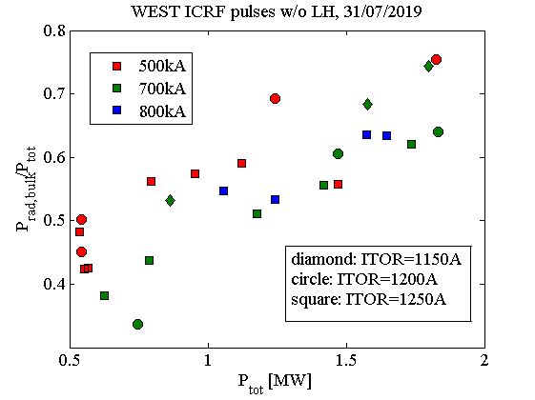
Radiated power fraction on 31/07
Target plasmas
Nl3=4,5-5e19
ICRH only.
Ip and Bt scans.
Good IC heating efficiency, except for off-axis heating
f_{rad} increases with P_{ICRH}
35-50% in ohmic, 60-75% with 1MW.
Different from LH behaviour.
Indicative of IC-specific contamination?
Parametric dependance
Slightly higher at I_{p}=500kA than higher I_{p}.
Slightly higher for off-axis heating (ITOR=1150A)

Slide 31
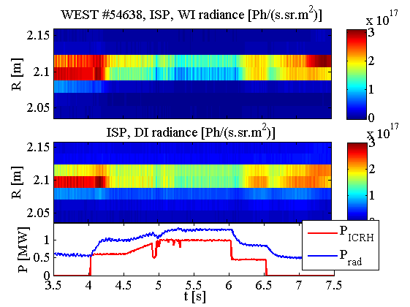
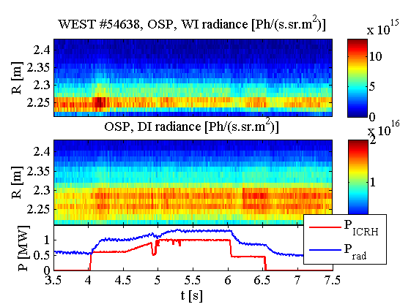
Divertor visible spectroscopy during ICRH
Inner divertor
Ip=700kA; ITOR=1250A
Outer divertor
Inner: Both DI and WI line radiance decrease during ICRH.
Outer: ~10× lower intensities, DI line radiance increases, WI radiance slightly decreases
Time delays, overshoot in divertor dynamics.
Lower conducted power during ICRH?

Slide 32
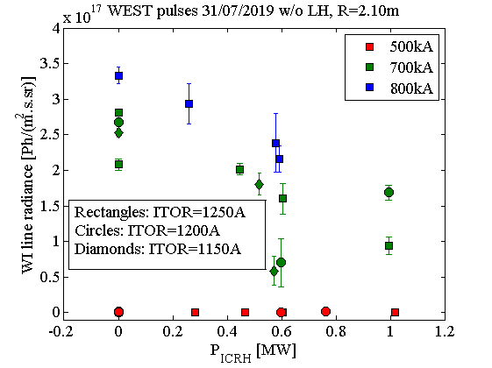
WI brightness inner divertor: parametric variation
Most intense divertor source
Trends opposite to f_{rad} variation.
Decreases with larger P_{ICRH}
Larger decrease for off-axis heating (ITOR=1150A).
Weak at I_{p}=500kA, increases with larger I_{p}.
Cannot explain higher contamination during ICRH

Slide 33
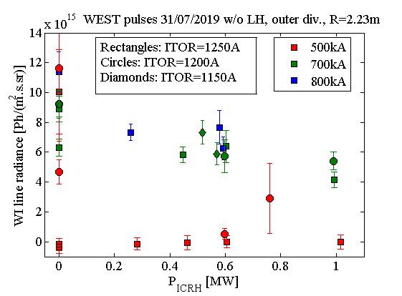
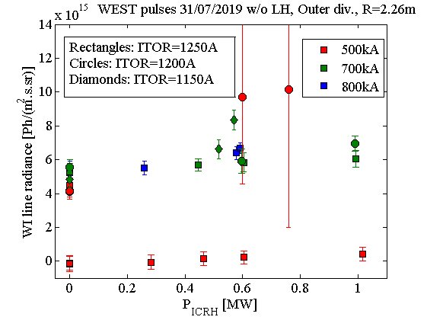
WI brightness, outer divertor: parametric variation
Signal levels ~10 times below inner divertor.
Very low for Ip=500kA, ITOR=1250A
Generally decrease with ICRF power.
Slight increase for some LODIVOU channels and off-axis heating.

Slide 34
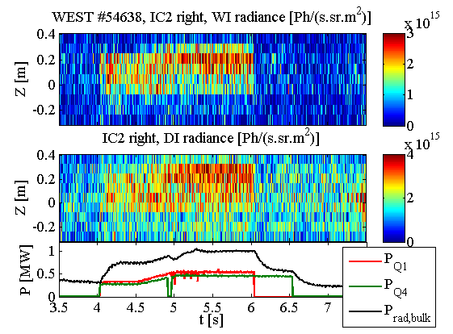
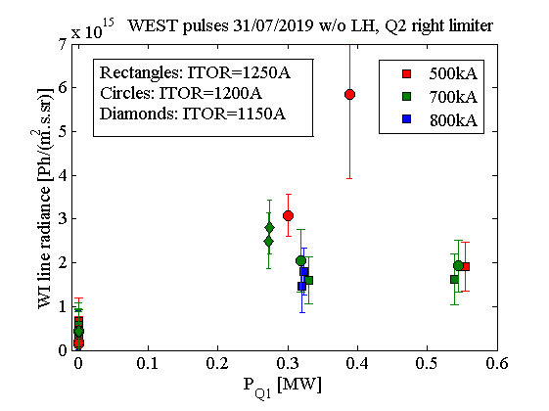
Main chamber W sources
Only antenna Q2 right limiter reacts to ICRH
Sensitive to Q1 antenna (magnetically connected to side limiter), not Q4.
Higher signals for off-axis heating and (Ip, ITOR)=(500kA, 1200A).
Prompt time response (no delay/overshoot).
Caveat: leading W sources in chamber probably missed !
Active antennas Q1 and Q4 not observed by visible spectroscopy.
Observed antenna Q2 used only at the begining of the session.

Slide 35
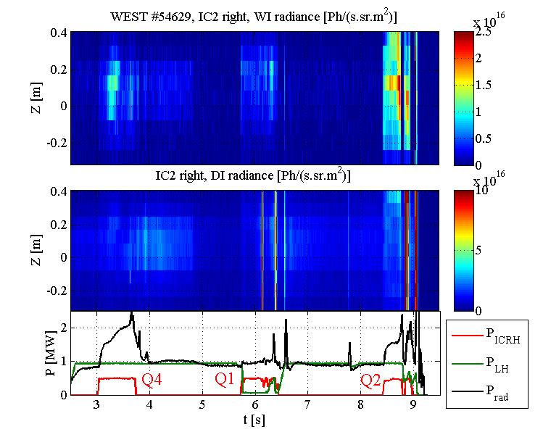
IC antenna limiter mainly reacts to local IC antenna

Slide 36
WEST #55192
IC Q2
Antenna limiter
Inner divertor
leading W source
Outer divertor

Slide 37
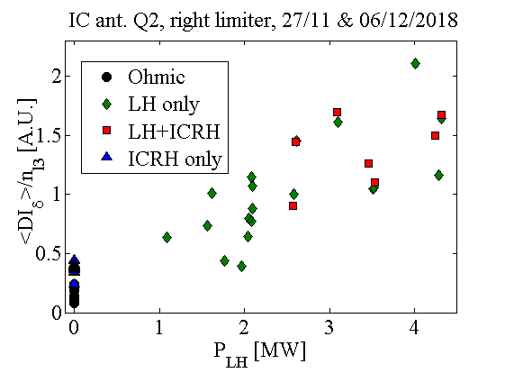
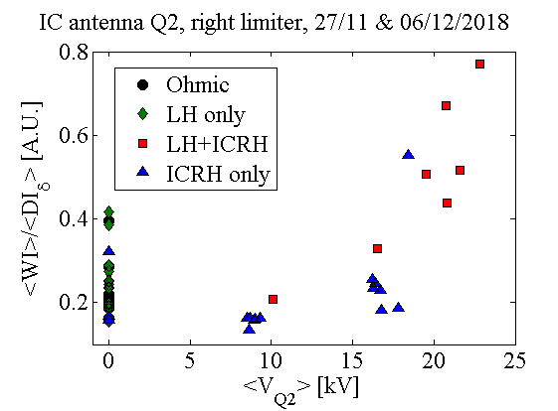
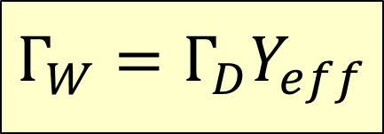
LH-IC combination on IC limiters in C3b
$$Γ_{W}=Γ_{D}Y_{eff}$$
Γ_{D}=f(n_{l}, P_{LH})
Proxy: DI_{δ} brightness on ant. limiter
Larger at high density ⬄ IC coupling
Increases faster than n_{l} with P_{LH}
W penetration also evoloves with n_{l}
Y_{eff}=g(T_{e},V_{Q2})
Proxy for Y_{eff}: line ratio WI/ DI_{δ}
Proxy for IC near field amplitudes: V_{Q2}
#53923
#53923
#53778
#53778

Slide 38
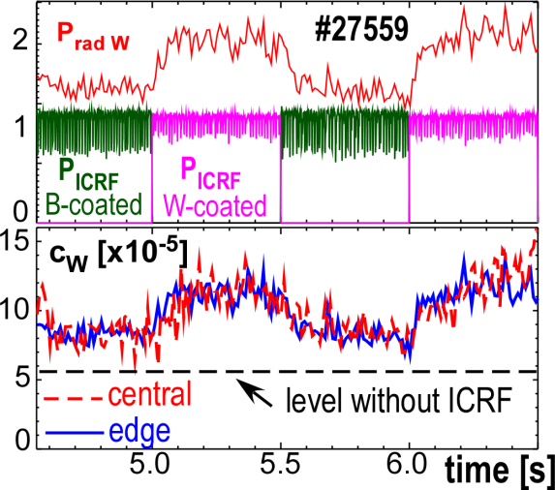
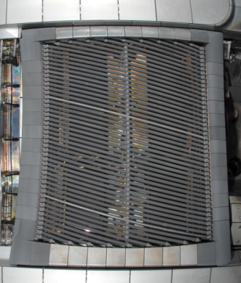
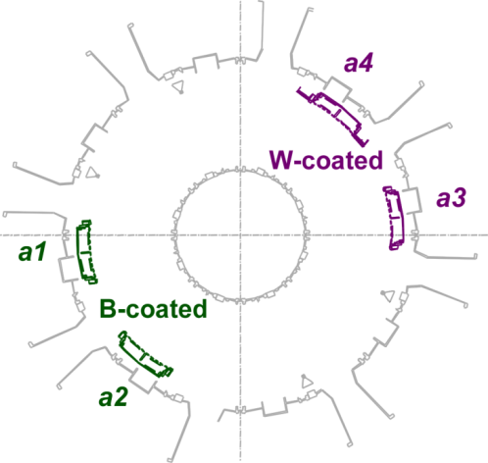
W- vs. B-coated limiter comparison in 2012
B-coated side limiters in 2012:
• Difference of about 50% of c_{W} rise
just because of toroidal limiters
• Rough estimate: all ICRF limiters account at
least for 70% of c_{W} rise in AUG, the rest
from other W structures.
V. Bobkov et al.
Workshop WEST
Aix, 2014!
• VUV spectroscopy: measured gain on P_{rad,W} is about 50% of applied ICRF power.

Slide 39
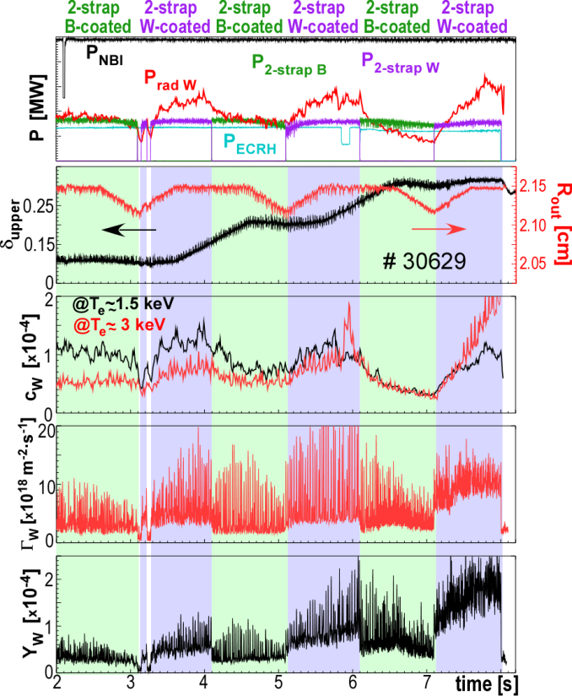
Sometimes higher gain, depending on configuration
ΔP_{rad,W}> P_{ICRH}

Slide 40

Issues with W at outer mid-plane on EAST
ASIPP
Before 2018:
W only on upper divertor,
C on LH limiters
USN/LSN ohmic pulse comparison.
After 2018:
W limiters installed ed on LH launcher.
USN /LSN comparison repeated
W_{USN}/W_{LSN} decreased by 3,5.
Estimated limiter contribution: 25% in OH.
Little ICRH power from the magnetically connected antenna has very large effect on W production compared to all others heating systems
| PAGE 40

Slide 41
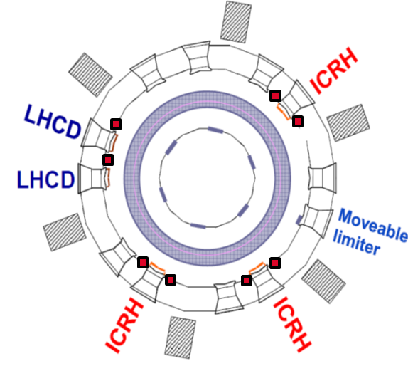
Q4am, bon emplacement pour une antenne bas-Z
L’auto-polarisation du plasma par rectification de gaine HF se propage sur de longues distances le long des lignes de champ ouvertes issues des antennes ICRH actives.
➔ éviter les connexions magnétiques aux autres PFCs-W.
Q4 est relativement éloignée des autres objets côté faible champ,
L’objet le plus proche est le LPA, qui peut être reculé franchement.
On ne pourra toutefois pas éviter des connexions de Q4 avec le baffle, qui existent aussi avec les autres antennes.
Q4am

Slide 42
Outlook
Need more margins on P_{sep} to get « useful » H-mode on WEST
P_{rad,bulk} higher with ICRH than with LH at similar power.
Especially when both systems are combined at high power.
Either the present experimental indications from WEST and AUG are convincing enough…
We should then boronize the side limiters on all 3 ICRF antennas.
Potentiel gain: f_{rad,bulk} similar with ICRH and LH.
B-coated limiters presently used on AUG. No operational issue reported in the litterature.
…Or they are not
It is then our duty to make a clear experimental comparison on WEST by ourselves.
Preference: boronize Q4 and keep Q2 with W coatings for DVIS measurements.
Potential reduction of P_{rad,bulk} increases with the number of B-coated antennas.
Additional remarks
Boron is already introduced on purpose every week on WEST.
Clear effect of W limiters on EAST plasmas.
Low-Z impurities will be present on ITER whatsoever. IC antennas surrounded with Be.
Long shutdown is the right moment to work on IC limiters.

Slide 43
SPARE

Slide 44
Dirvertor sources
Assumptions on inner div
On average Гw=2.10¹⁸atm/s
Radial extention ~ 4cm
Toroidal extention = 360°
Assumptions on outer div
On average Гw=10¹⁷atm/s
Radial extention ~ 10cm
Toroidal extention = 360°
Remarks
Similar with all heating schemes
Some screening effect
Source estimation

Slide 45
Limiters sources
Assumptions
On average Гw=10¹⁷atm/s
Poloidal extention ~ 50cm
Toroidal extention ~ 10cm
3 ICRF antennas ON → 6 limiters
Remarks
Negligible when not powered
No screening effect
Source estimation

Slide 46

L’ICRH, souvent « inutile » pendant C3b
Sur les chocs les plus performants de la campagne C3b, la quasi-totalité de la puissance ICRH injectée était rayonnée par le plasma (vs. 50-60% pour LH).
Dans l’état actuel des choses la puissance ICRH contribue peu (voire pas)
À la transition du plasma en mode H.
aux flux de chaleur sur les monoblocs de divertor.

